Slide 1
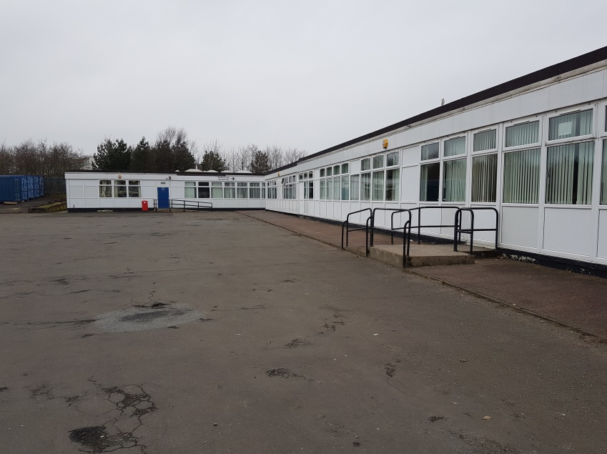
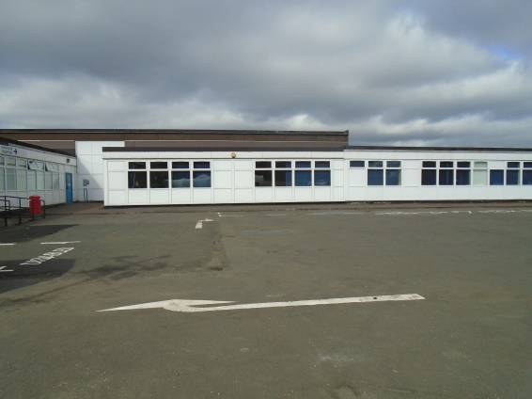


The Skills Centre
August 2020

Slide 2
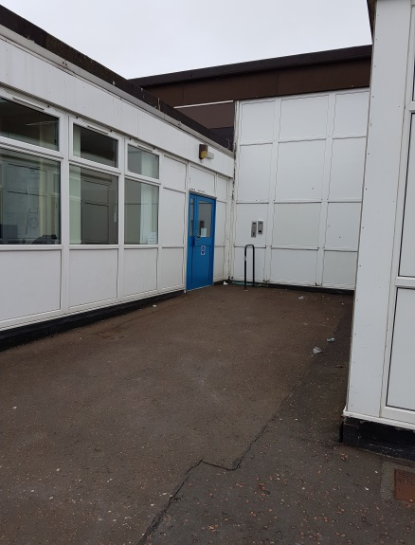
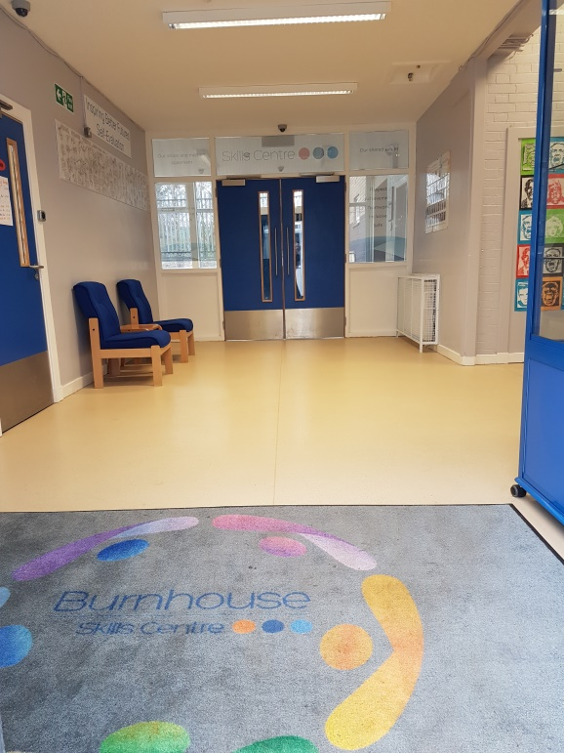

Arriving at the Skills Centre
You will be brought to the Skills Centre by taxi.
You will come in through this door.
Press the buzzer and you will be let inside.
The Reception Area looks like this.

Slide 3
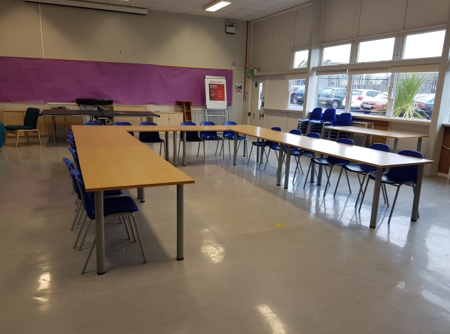
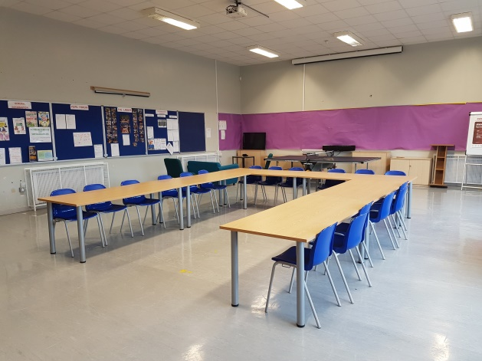
Skills Centre Dinner Hall
When you arrive in the building you can go to the dining room to wait.
There will be staff and other pupils in here.
This is where you can order lunch in the morning.

Slide 4
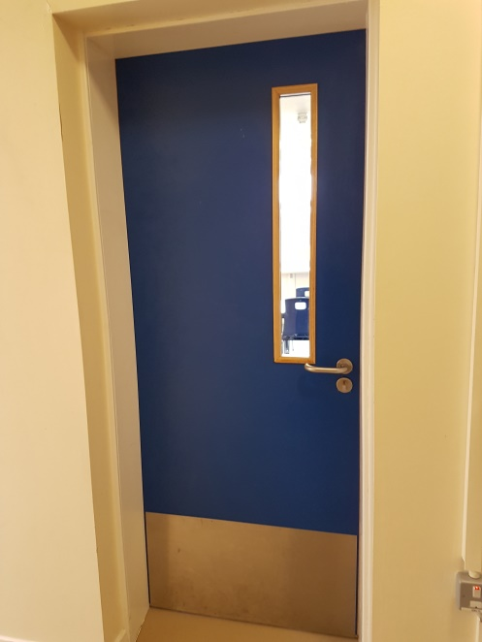
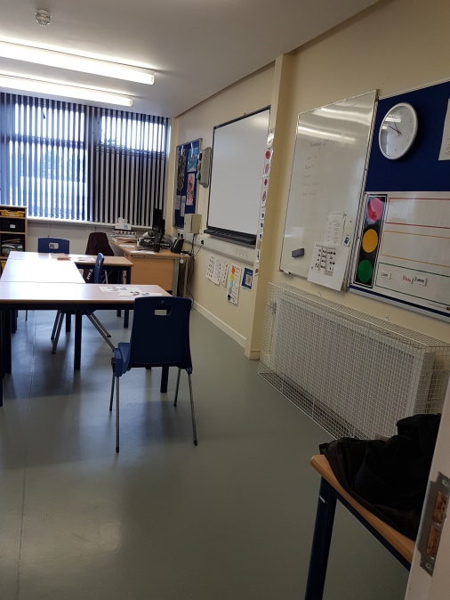
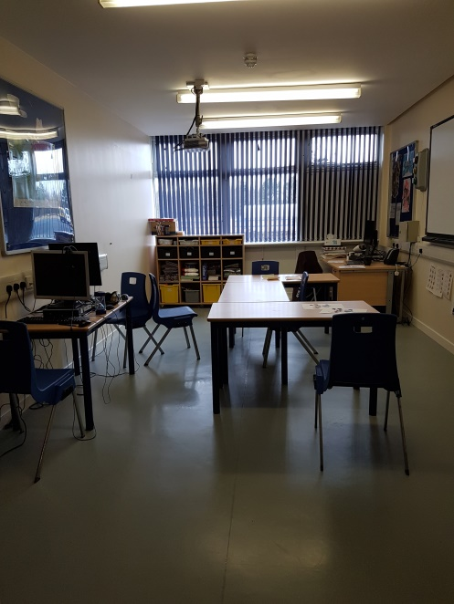
Core Classroom
This is the Core Classroom you will be working in every morning.

Slide 5
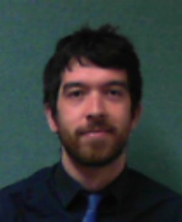
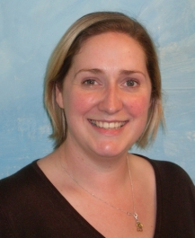
Core Classroom Adults
The two adults in Core class will be
Mr Rankin
Mrs Mackenzie

Slide 6

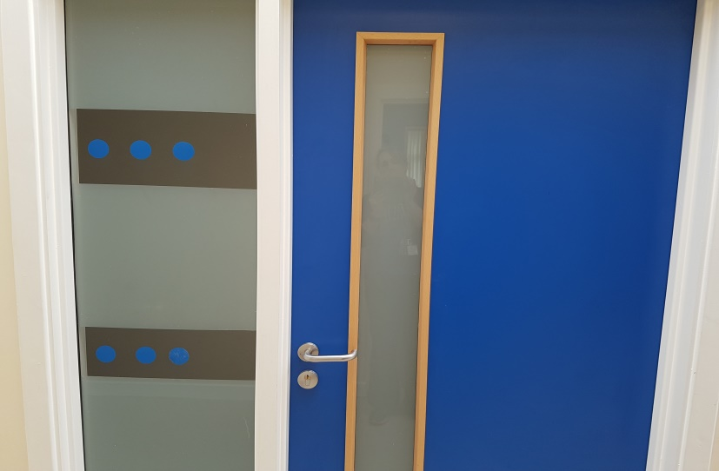
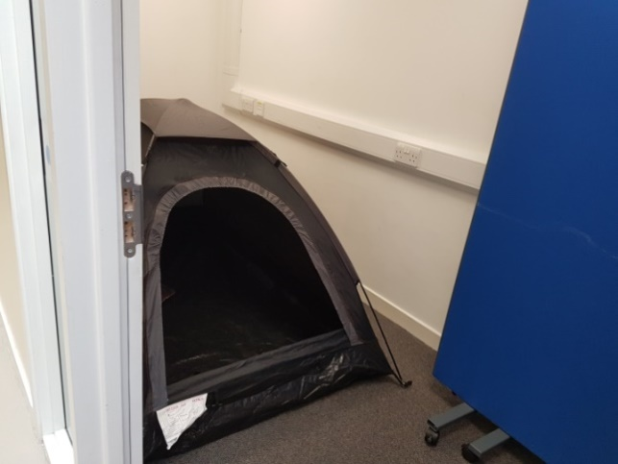
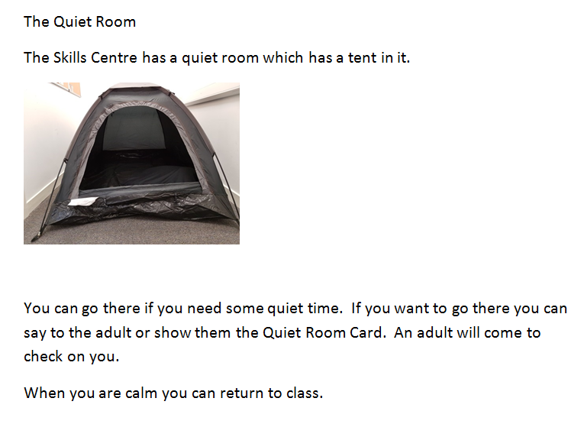
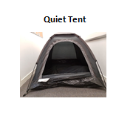
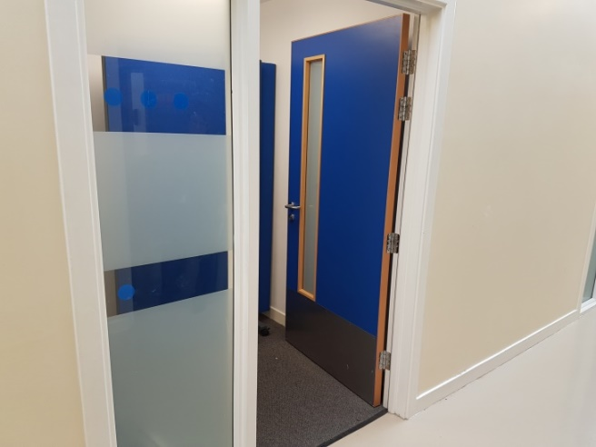
Quiet Room
If you become upset in class you can go to the Quiet Room across the corridor. You can return to class when you are calm.

Slide 7
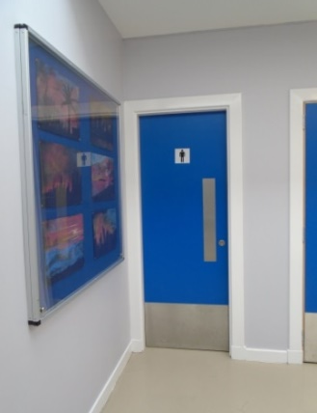
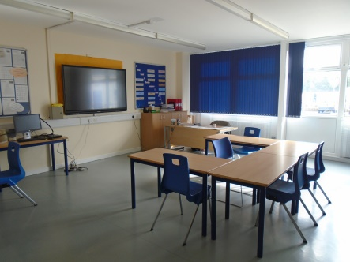
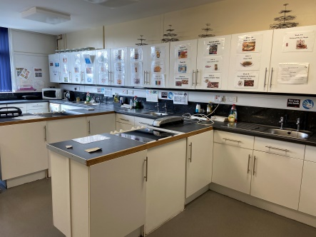
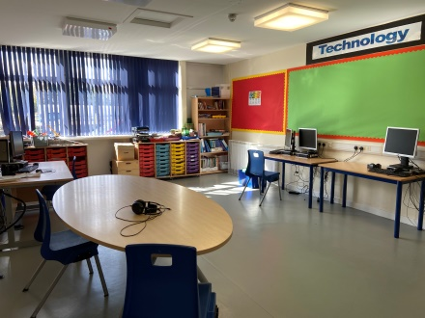
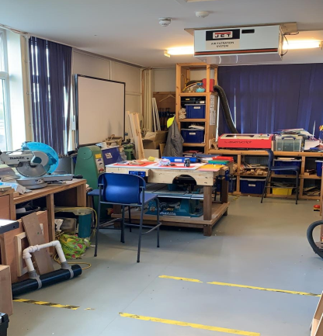
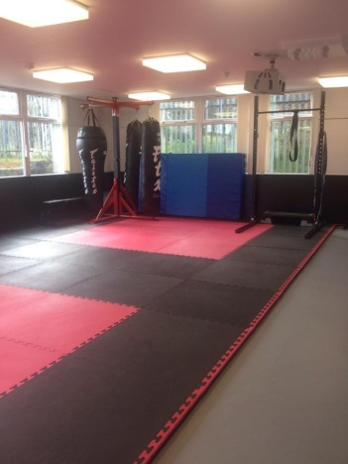
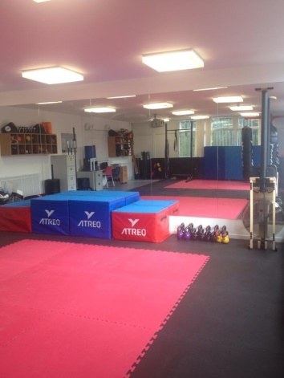
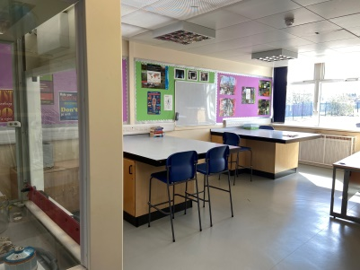
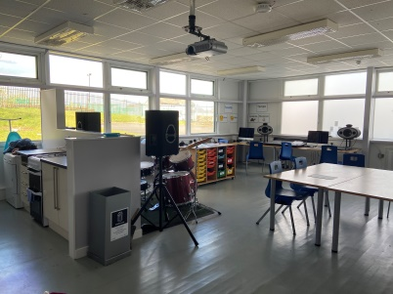
Rooms I will use at the Skills Centre
Maths
Home Economics
ICT room
Toilets
Science
Expressive
Arts
CDT
Sit Fit Gym

Slide 8
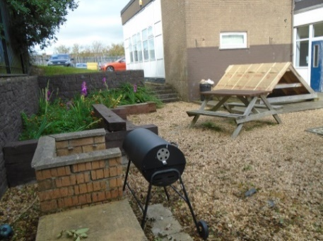
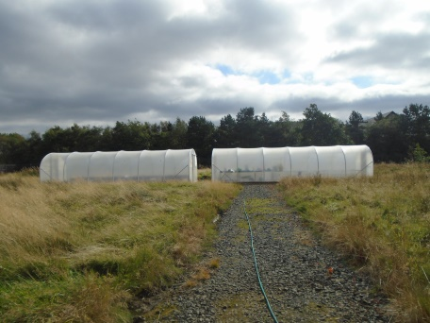
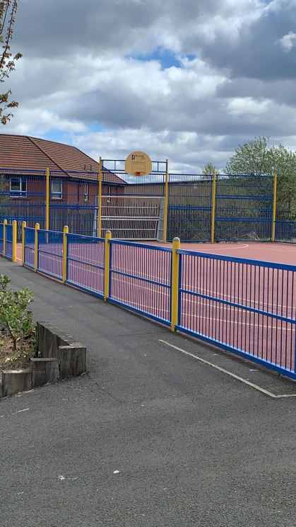
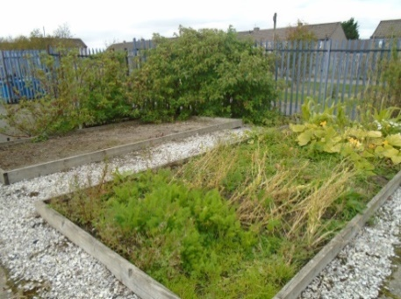
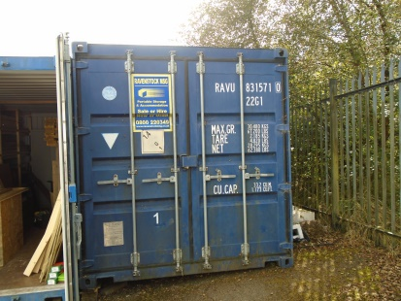
Outdoor Spaces at the Skills Centre
BBQ Area
Poly Tunnels
Muga
Containers
Raised planters

Slide 9
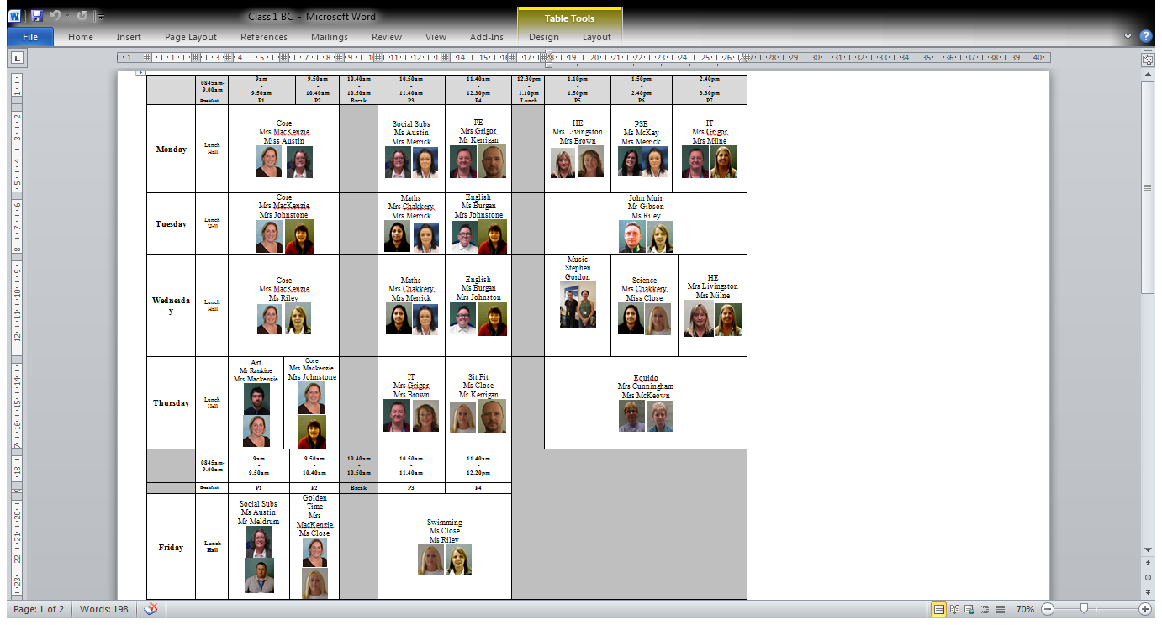
Timetable
Your timetable will look like this, with a picture of the teachers.

Slide 10

Daily Routine
8.30-9am – Taxi to Skills Centre, you will sit in the back seat of the taxi. When you arrive go into the dinner hall where you can have something to eat and drink if I want to. This is when to order your lunch.
9- 10.40 am - Period 1 is from 9 to 9.50am and period 2 is 9.50 to 10.40am.
10.40-1.50am - Break time. You can go to the dinner hall , the muga or a classroom to eat your snack.
10.50am - Period 3 is 10.50 to 11.40am and period 4 is 11.40 to 12.30pm.
12.30pm – Lunch time. In the dinner hall you join the queue to collect lunch. You can sit anywhere in the dining hall. After you have eaten you can go outside, to a classroom or stay in the dinner hall.
1.10pm - Period 5 starts and finishes at 1.50pm. Period 6 is from 1.50pm until 2.40pm. Then period 7 is from 2.40pm to 3.30pm.
3.30pm – End of school. You will be collected by your taxi and taken home. You can sit in the back seat of the taxi.

Slide 11
Materials I will need
Pens and Pencils
Gym kit
Calculator
Homework tasks
Water bottle
Snack

Slide 12
Uniform
The uniform at the Skills Centre is black trousers or black jogging bottoms, a school t shirt or a shirt and school tie.
You can wear trainers, preferably black.
For PE and Sit Fit, you must bring a separate PE kit of shorts and t shirt.
For Equido, gardening or John Muir Trust you should bring warm clothes for being outside. If you have your own wellies you can bring them or borrow a pair from school.

Slide 13
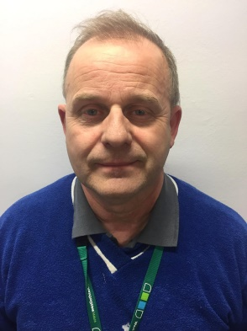
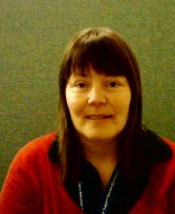
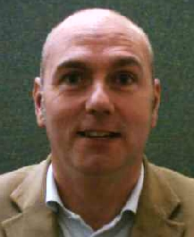
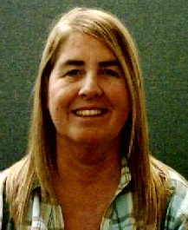
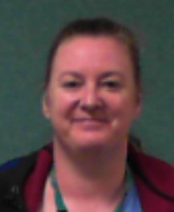
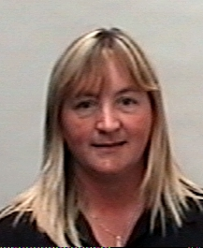
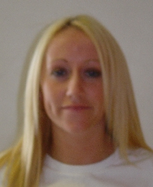
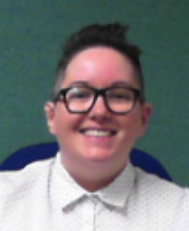
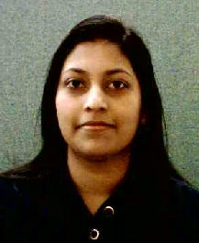
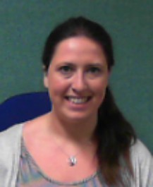

Adults on Your Timetable
Mr Jackson
Mrs Johnstone
Mr Denholm
Mrs Milne
Mrs Grigor
Mrs Livingston
Mrs McDonald
Miss Burgan
Mrs Chakkery
Miss Ferri

Slide 14
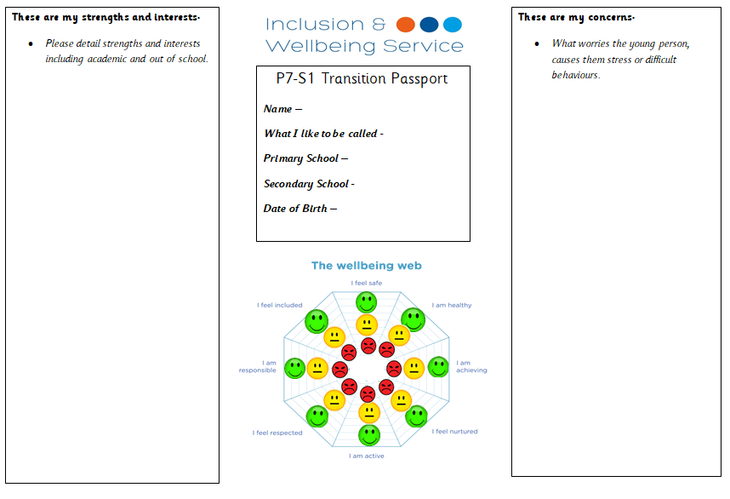
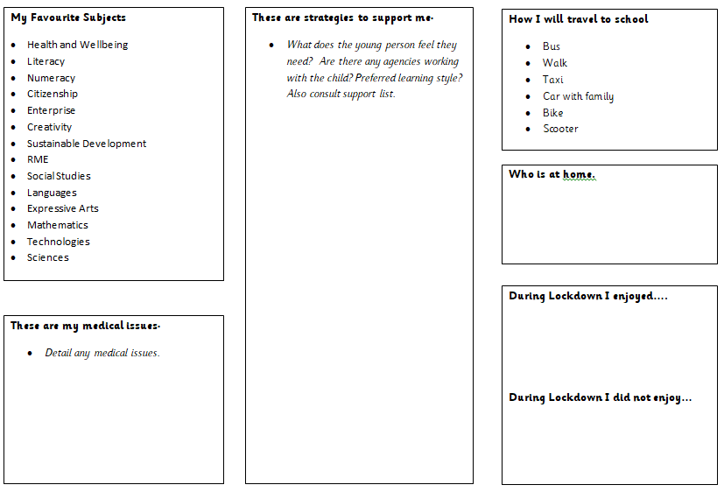
IWS Pupil Passport
The IWS P7-S1 Transition Passport
is a communication tool that will
support staff in understanding and
building relationships with pupils.
The Transition Passport should have
input from the pupil, home and class
teachers to give a holistic view.
There is a prompt sheet and a Transition Passport example to support completion.

Slide 15

Important Dates

